Slide 1
Cross-platform apps development using MAUI
Иван Џиковски
Ведра Стојановска

Slide 2
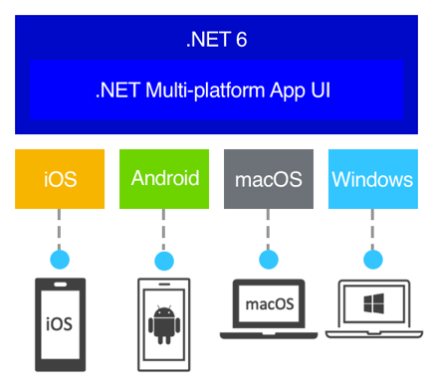
.NET Multi-platform App UI (.NET MAUI)
Cross-platform framework for creating native mobile and desktop apps with C# and XAML.
Allows us to develop apps that can run on Android, iOS, macOS, and Windows from a single shared code-base.

Slide 3
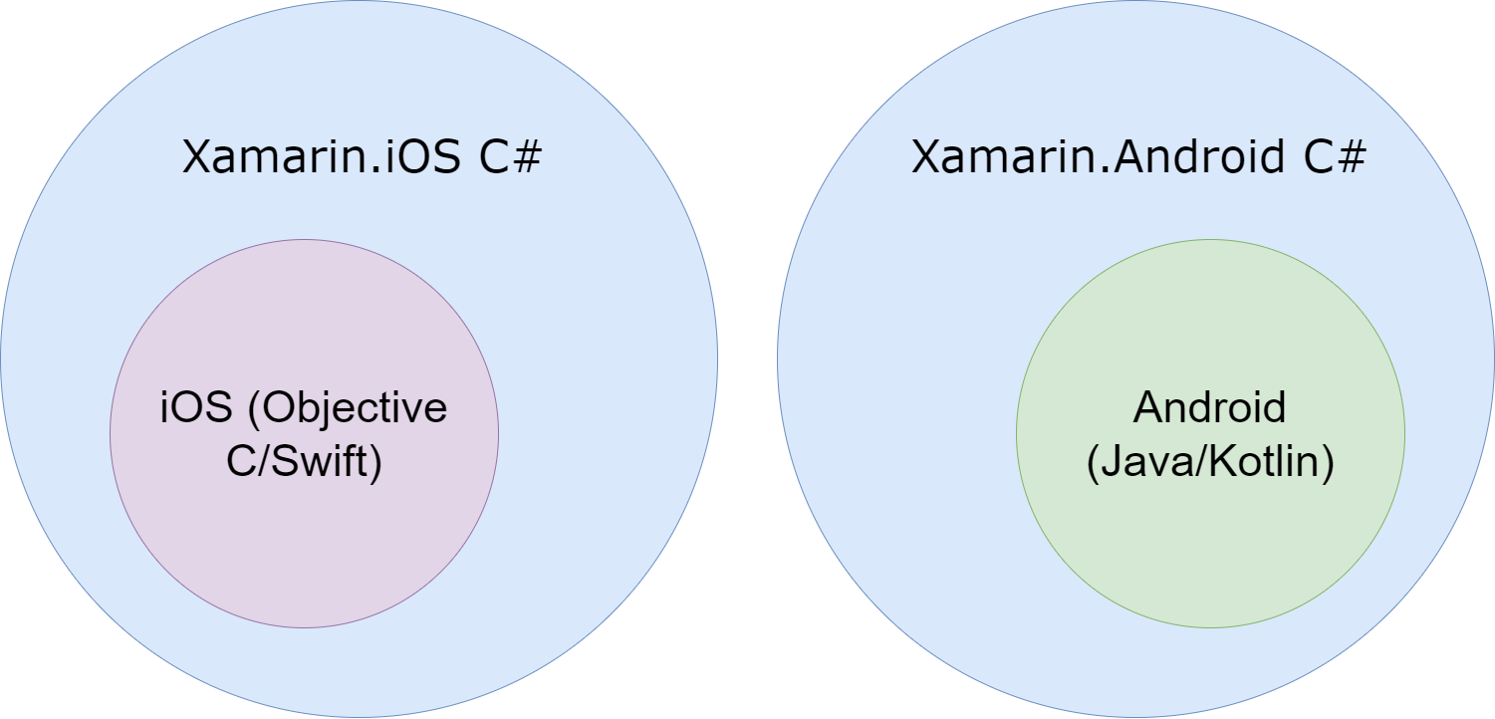
What is Xamarin?

Slide 4
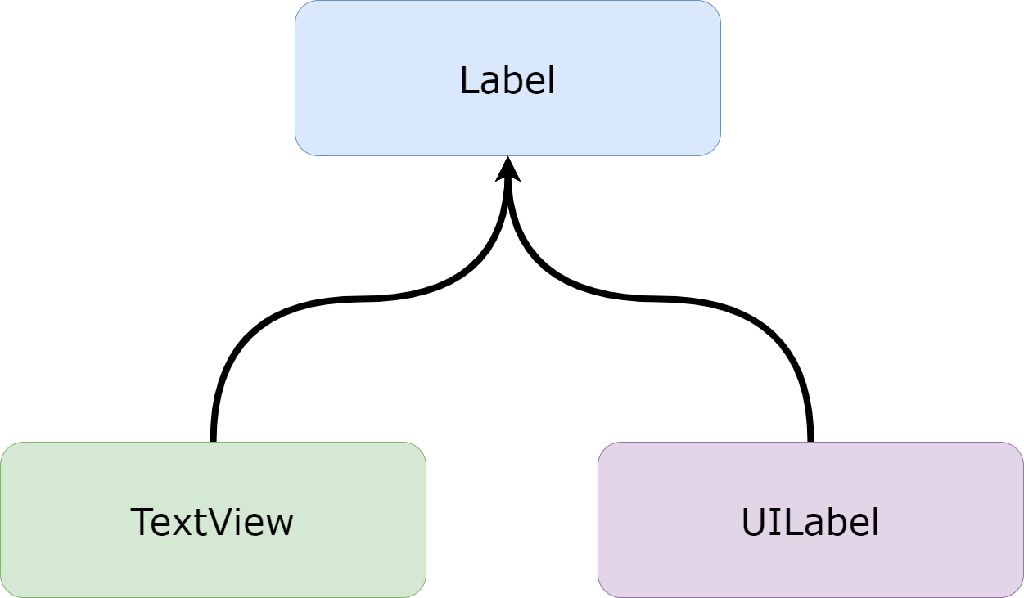


Xamarin.Forms

Slide 5
MAUI vs. Native
MAUI App Development
C# for both iOS and Android
One code base and one team for iOS and Android
Faster development
Lower performance compared to native apps
Latest features and improvements available after Xamarin update
Native App Development
Swift for iOS and Kotlin for Android
Multiple code bases and teams to support iOS and Android
Time consuming development
High performance in native built apps
Latest features and improvements available right away

Slide 6
High Level Course Overview
Building native apps using XAML and C#
Creating designs using Layouts and UI Components
Decoupled Apps by using the MVVM Pattern
What is Data Binding and how does it work
Working with local data and consuming REST APIs
Creating backend services and integrating the App
Deploying and Distributing Xamarin.Forms Applications

Slide 7
Course Format
Short theory intro about one to two slides
Sandbox App examples
Real Estate App
No homework
Code will be pushed to GitHub after each class

Slide 8
Setting up the environment
https://learn.microsoft.com/en-us/dotnet/maui/get-started/first-app?pivots=devices-windows&tabs=vswin

Slide 9
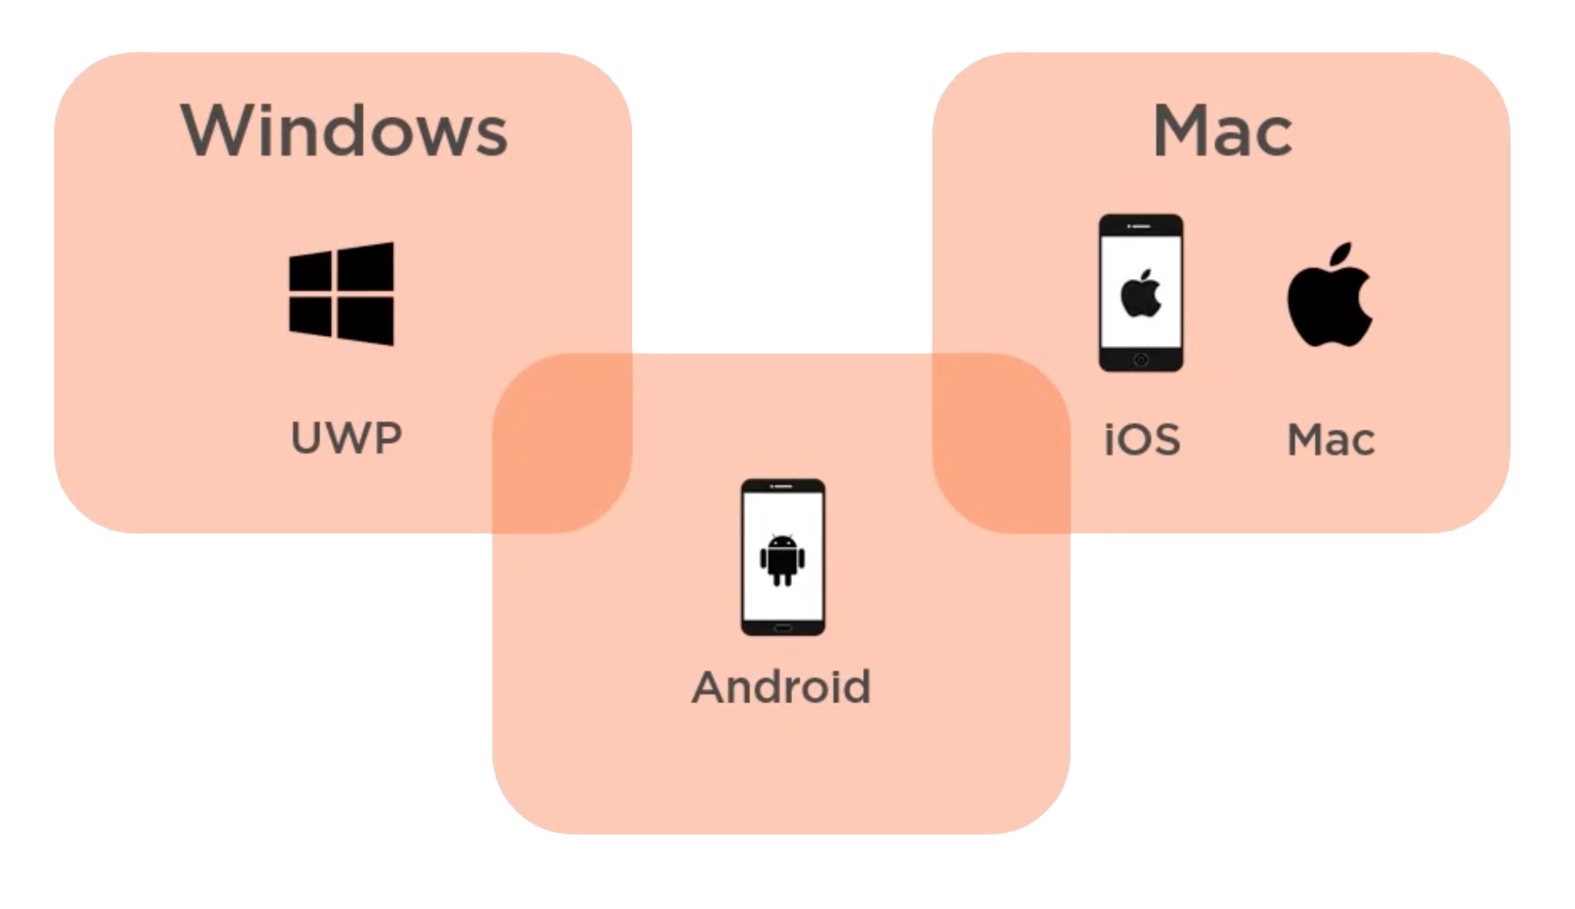
MAUI Development Environment

Slide 10
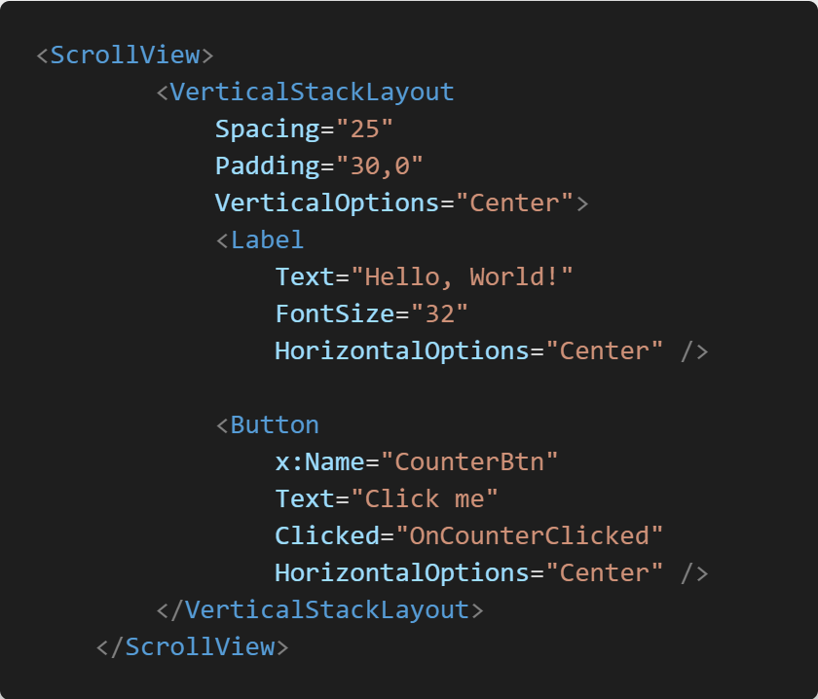
XAML Overview
Declarative way to define the UI
Based on XML
Similar to HTML
Create objects behind the scenes

Slide 11
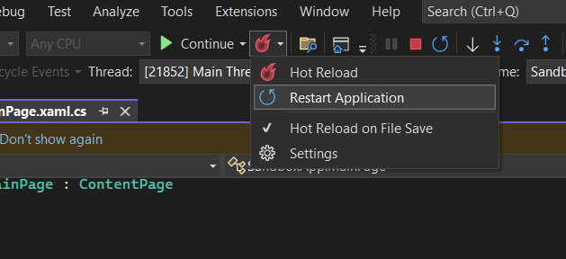
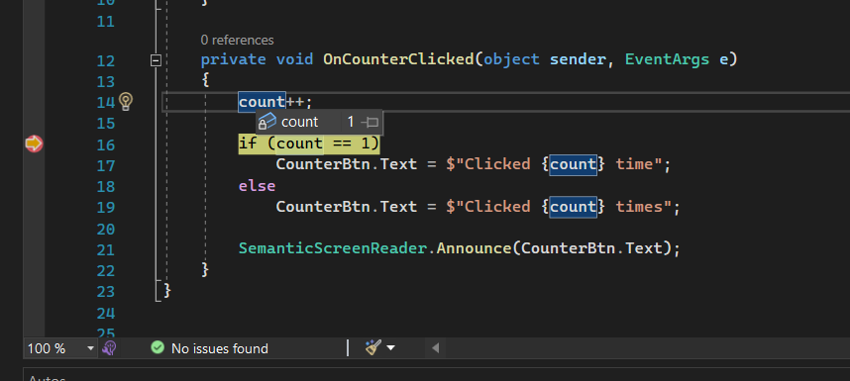
Debugging and Hot Reload

Slide 12
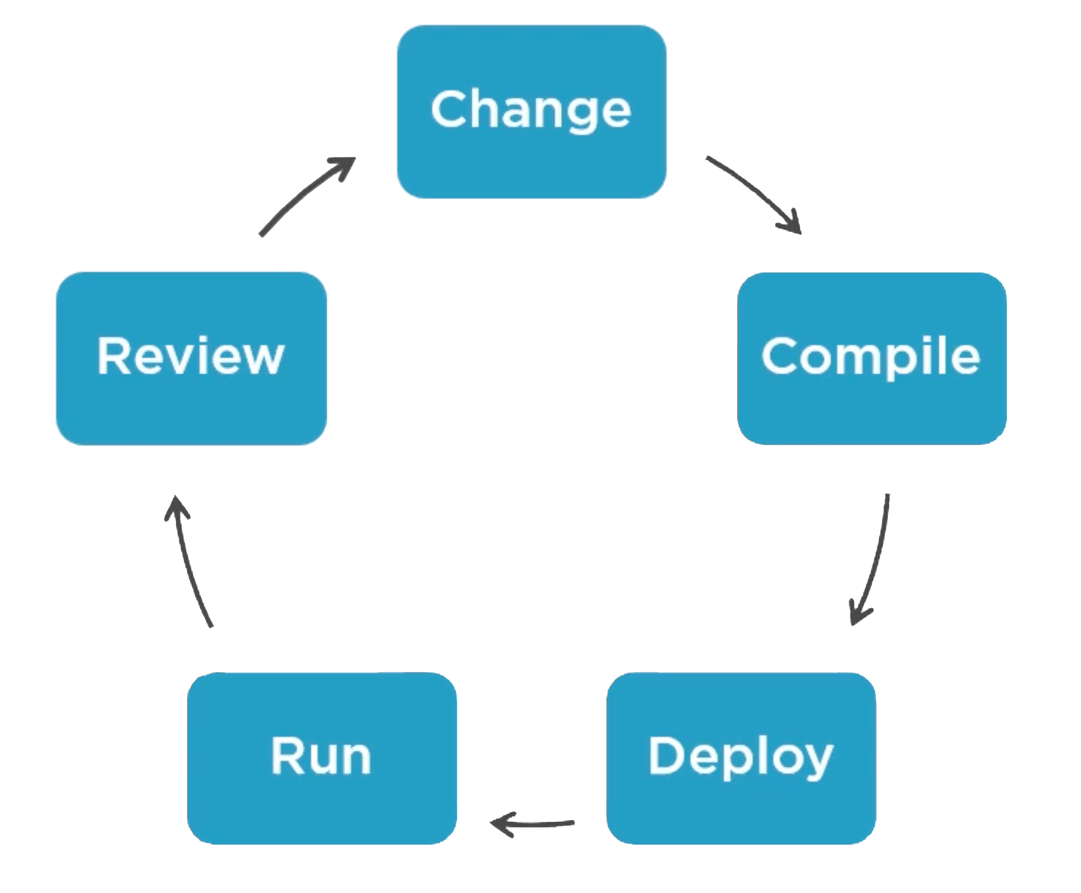
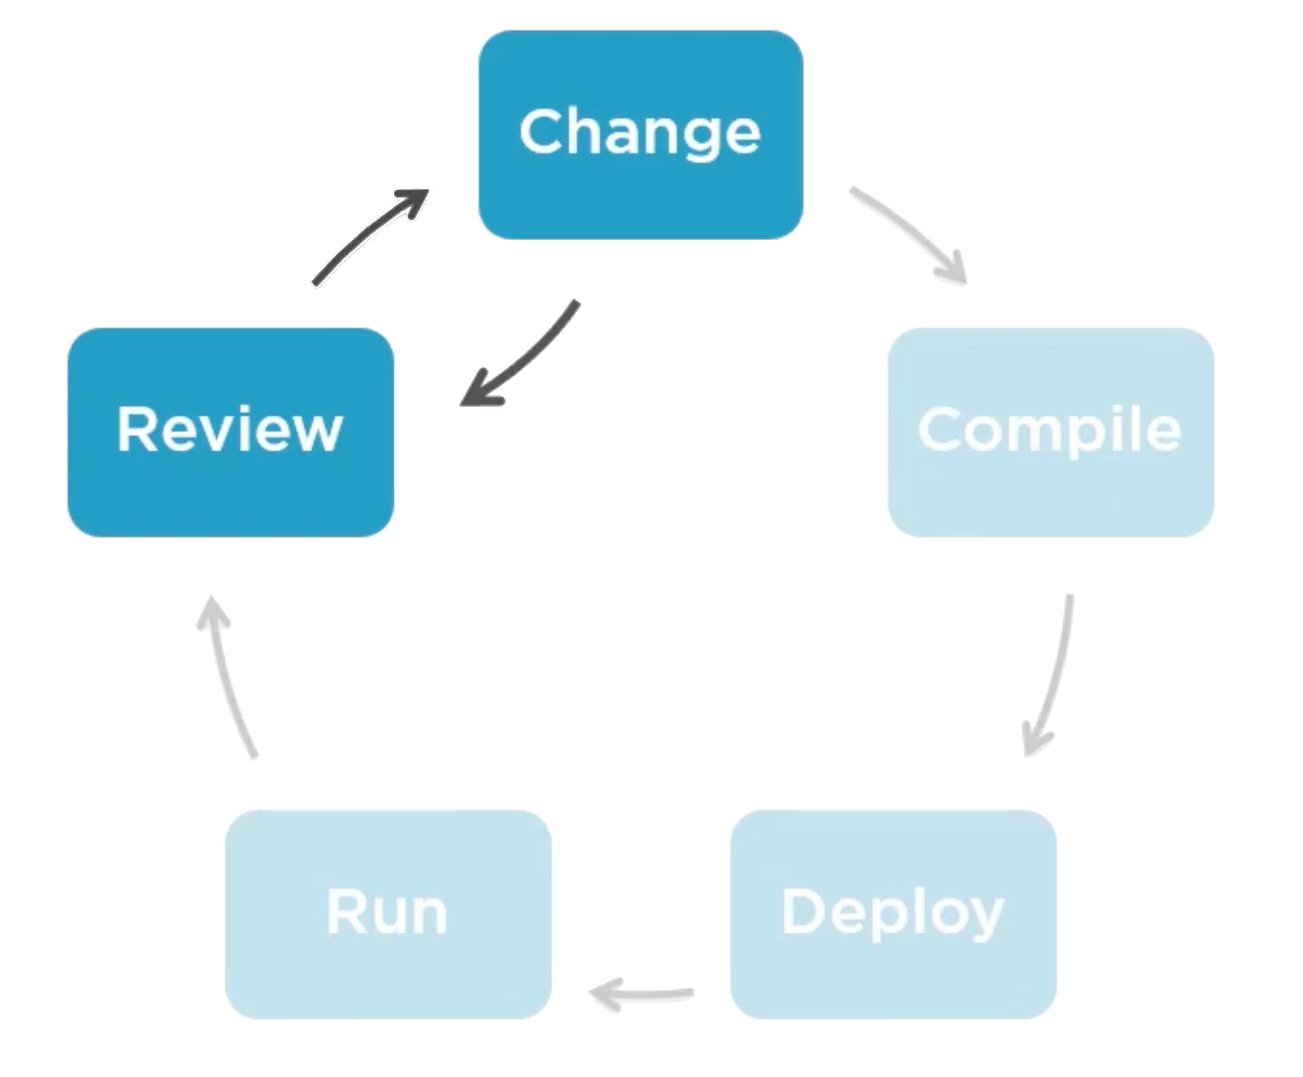
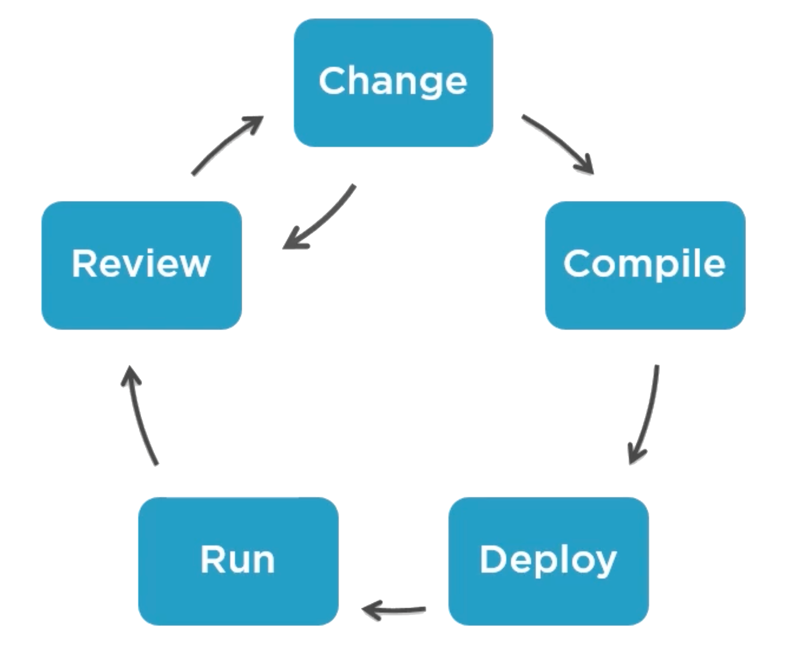
Mobile Development Iteration Loop

Slide 13
QUESTIONS?
You can find us at
ivan.dzikovski@gmail.com
vedrastojanovska@gmail.com
You can find the code at
Repository with the code Link

Slide 14
Discussion

